Slide 1


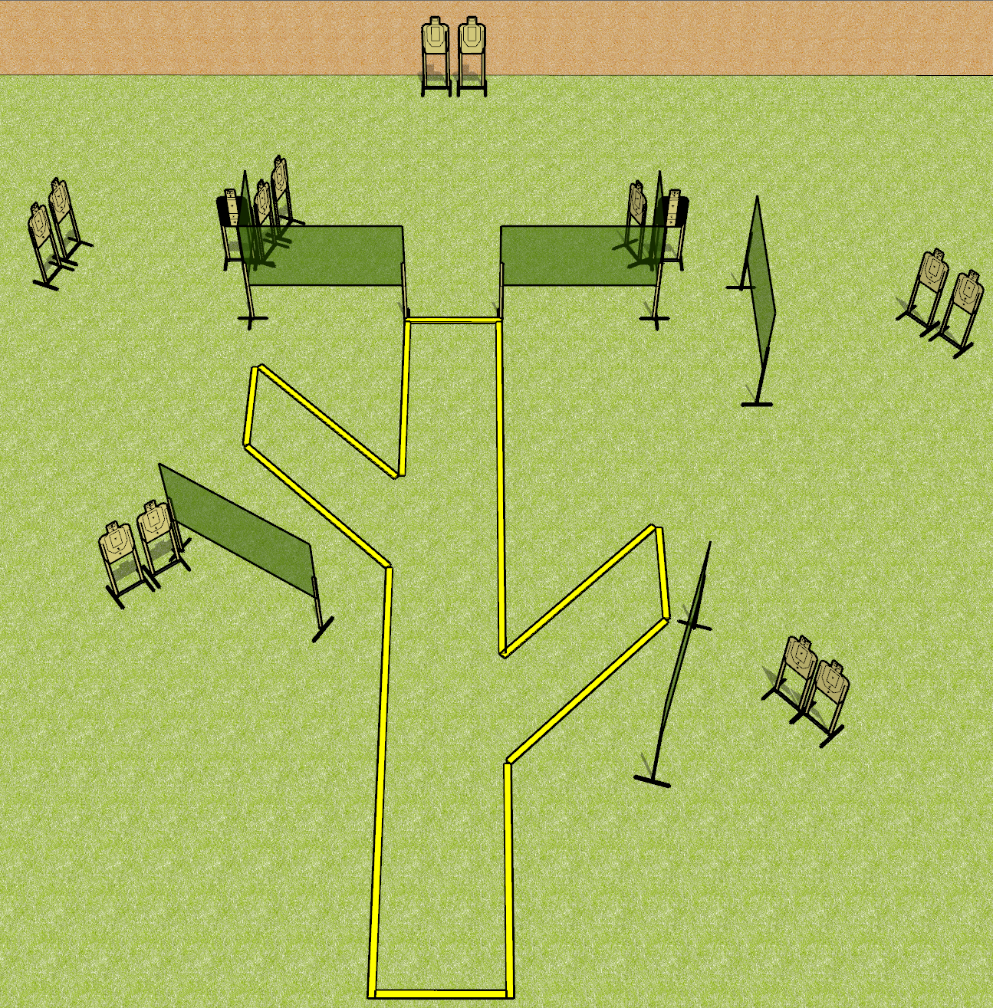
 | Dothan Gun Club – USPSA Match Branching Out Course Designer : Drew Coleman
Round Count 30 rounds 15 USPSA
Equipment List 4 medium fault lines 12 wall feet 2 tux 13 targets

Slide 2
Branching Out
Written Stage Briefing
Branching Out is a 30 round, 150 point, Comstock course of fire. There are 15 USPSA targets. The best 2 hits on paper will score.
Handgun start position is toes touching rear fault line, facing uprange, wrists above shoulders. Handgun is loaded and holstered.
PCC start position is heels touching rear fault line, stock on belt. Loaded carbine is held with both hands, safety on.
On the audible start signal, engage targets as they become available from within the shooting area.

